Slide 1

DEPARTMENT OF COMPUTER SCIENCE AND ENGINEERING
Professional Training - 1
Title
QR CODE GENERATOR
PROJECT STUDENT GUIDE
SANDEEP YALAMANCHILI, Dr.KALAYARASI, 42111130 Associate Professor, CSE

Slide 2
AGENDA
Certificate
Introduction
Abstract
Objective
System Architecture / Ideation Map
Module Implementation
Results and Discussions
Conclusion
References

Slide 3
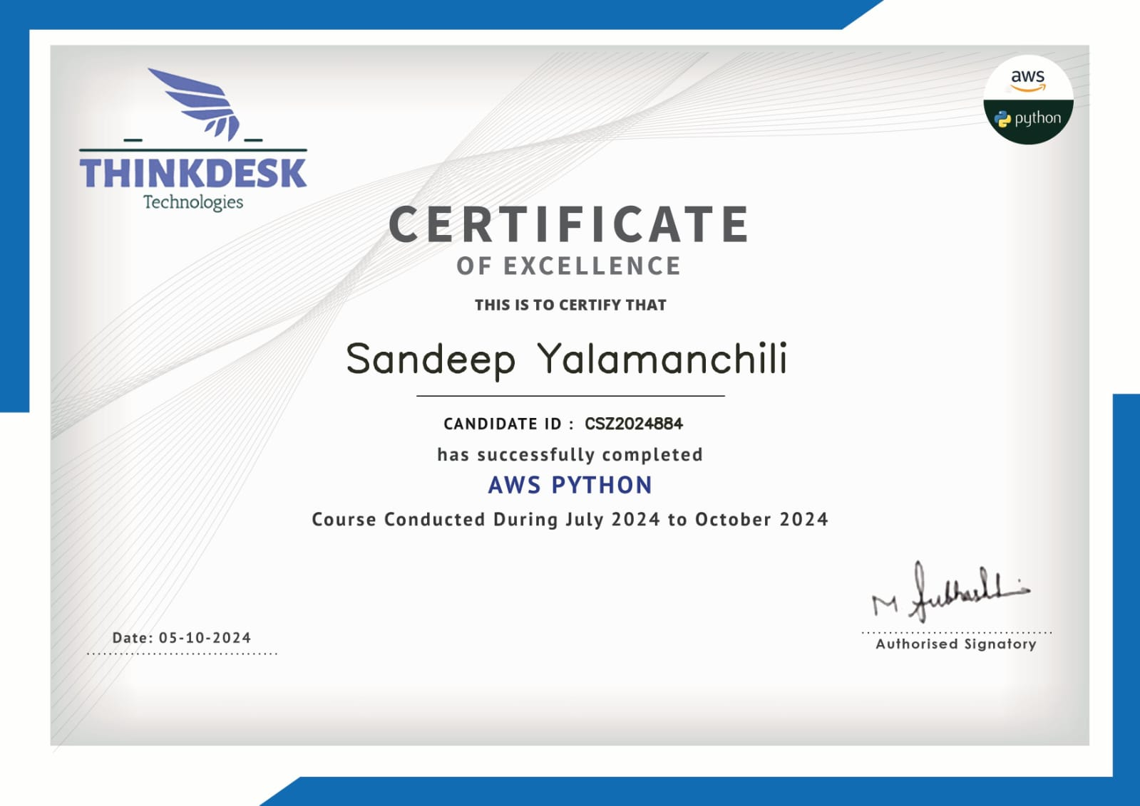
COURSE CERTIFICATE

Slide 4
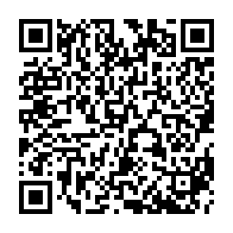
INTRODUCTION
In today's tech-driven world, QR codes are an efficient tool for sharing information quickly. This project develops a QR Code Generator using Python and the PyQRCode library, allowing users to create scannable QR codes from any text or URL. The tool supports single or multiline input and generates high-quality PNG files for use across digital and print platforms.
A standout feature is the ability to modify QR code content post-generation, providing flexibility for updates. Additionally, AWS S3 integration enables secure cloud storage, making QR codes accessible, shareable, and protected with encryption and access controls. This project demonstrates the practical application of Python and cloud technologies to solve real-world challenges.

Slide 5

ABSTRACT
This mini project focuses on developing a “QR Code Generator” using Python and the PyQRCode library, allowing users to create QR codes from any text or URL. It supports both single-line and multiline inputs, saves QR codes in PNG format, and enables post-creation content modification.
A key feature is the integration with AWS S3 for secure, cloud-based storage and easy access to generated QR codes. Developed as part of an AWS Python course for a bachelor's degree, this project demonstrates how Python and cloud technologies can be applied to enhance digital asset management.

Slide 6

OBJECTIVE
The objective of this project is to develop a versatile QR Code Generator using Python and the PyQRCode library, providing users with an easy and efficient way to create, modify, and manage QR codes. The tool allows input of text or URLs, supporting both single-line and multiline formats, and generates QR codes in high-quality PNG format for use in digital or print applications.
A key feature is the ability to modify QR code content even after creation, offering flexibility for updates. Integration with AWS S3 ensures secure cloud storage, allowing users to access and share their QR codes from anywhere. This project, developed as part of an AWS Python course, demonstrates the real-world application of Python and cloud technologies for managing digital assets efficiently and securely.

Slide 7
LITERATURE SURVEY
QR codes, invented in 1994 for tracking automotive parts, have become widely used in various industries for fast information sharing, mobile marketing, and contactless services. Research highlights the efficiency of QR codes in retrieving information quickly, making them ideal for digital and print use. Python, known for its simplicity, is often used for QR code generation, with libraries like PyQRCode providing flexible and scalable solutions for creating high-quality codes.
Cloud integration, especially with Amazon Web Services (AWS) Simple Storage Service (S3), adds value by offering secure, scalable storage. Studies show that AWS S3's encryption and access control features ensure data protection, making it a reliable solution for managing large volumes of digital assets.
This project combines the ease of QR code

Slide 8
SYSTEM ARCHITECTURE / IDEATION MAP
User Interaction:
Input text/URLs via GUI/CLI; option to modify existing QR codes.
QR Code Generation:
Python script with PyQRCode creates scannable QR codes in PNG format.
AWS S3 Integration:
Upload QR codes to AWS S3 for secure cloud storage; supports public/private links.
Modification:
Update QR code content post-generation and re-upload modified codes to S3.
Data Flow:
Input → Generate → Save → Upload; Modify → Regenerate → Re-upload.
Optional Database:
Track QR code activities (e.g., DynamoDB).
Security:
Role-based access via AWS IAM; data encryption in transit and at rest.
This architecture provides a secure and user-friendly solution for managing QR codes.

Slide 9
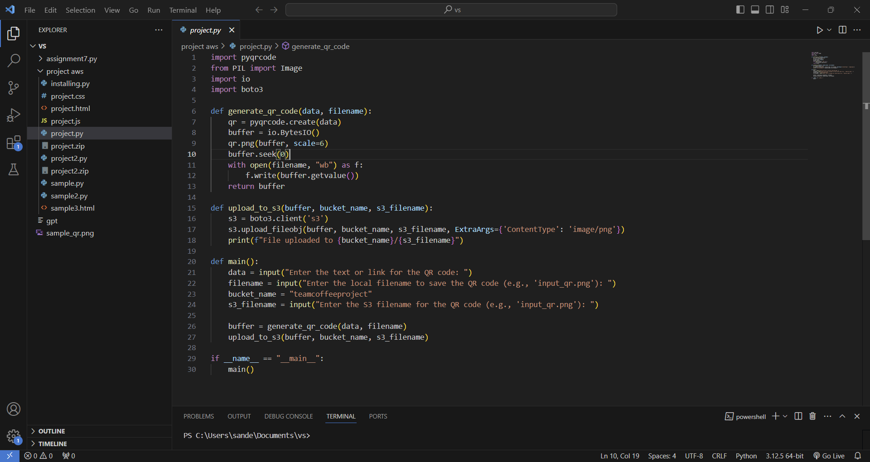
MODULE IMPLEMENTATION

Slide 10
RESULTS AND DISCUSSIONS
Functionality:
Successfully generated and modified QR codes from text/URLs.
Performance:
Fast QR code generation and seamless upload to AWS S3 for secure storage.
User Experience:
Intuitive interface; cloud storage appreciated for easy access.
Security:
AWS IAM policies and encryption ensured secure access to data.
Limitations:
AWS S3 setup complexity; potential for bulk generation and analytics enhancements.
Future Work:
Plans for QR code scanning and improved user interaction tracking.
This project demonstrates effective QR code management using Python and AWS S3.

Slide 11

CONCLUSION
The QR Code Generator project effectively leverages Python and the PyQRCode library to create a user-friendly tool for generating and managing QR codes. By integrating with AWS S3, the solution provides secure cloud storage, ensuring that generated QR codes are accessible and protected. The ability to modify existing QR codes enhances flexibility, allowing users to update information without the need for regeneration from scratch.
Overall, this project showcases the practical application of modern technologies in creating scalable and efficient solutions for digital asset management. Future enhancements, such as QR code scanning capabilities and advanced analytics, can further improve user experience and broaden the tool's functionality. This initiative not only fulfills its objectives but also sets the stage for ongoing development in the realm of QR code technology.

Slide 12
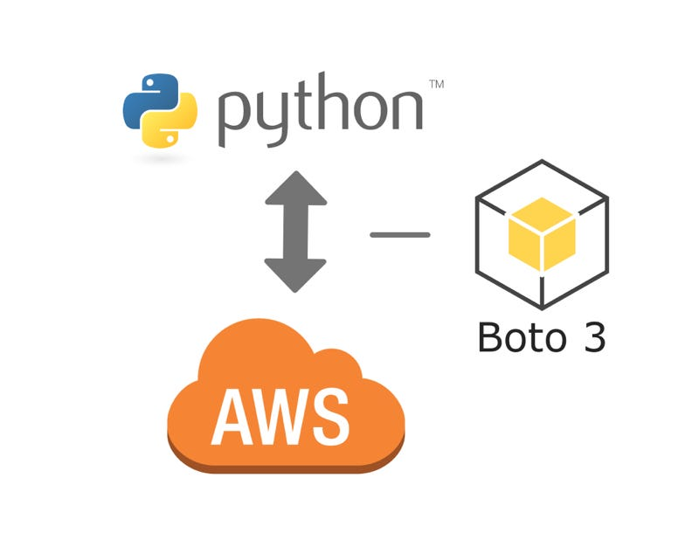
REFERENCES
PyQRCode Documentation: PyQRCode. (n.d.). Retrieved from https://pypi.org/project/PyQRCode/
AWS S3 Documentation: Amazon Web Services. (n.d.). Retrieved from https://aws.amazon.com/s3/
Boto3 Documentation: Amazon Web Services. (n.d.). Retrieved from:https://boto3.amazonaws.com/v1/documentation/api/latest/index.html
AWS Security Best Practices: Amazon Web Services. (n.d.). Retrieved from https://d1.awsstatic.com/whitepapers/aws-security-best-practices.pdf
QR Code Technology: Jaeger, D. (2018). Journal of Information Technology, 23(1), 45-50.
Cloud Storage Solutions: Kaur, A., & Singh, S. (2020). International Journal of Computer Applications, 975, 8887.

Slide 13

THANK YOU
Thank you for your attention and participation.
Your support means a lot, and I appreciate your time.

